Slide 1
Using DI and IOC: Mocking and Testing

Slide 2
About me:
Application/Cloud Architect UMB
20+ years of software development
First program on Apple II in 4th grade (8 years old)
Cobol, Fortran, Mark IV
VB6, VBS, VBA, VB.NET, C#, JavaScript
.NET Framework 1-4, .NET Core 1-2
Node.JS
JQuery, Angular, Bootstrap, etc.
Higher education, Banking and Finance, Legal Discovery, CRM, Advertising
Married HS sweetheart (met at 15, married at 19, married 29 years)
One son, currently in Medical School ($$$$$)
YASDB (Yet Another Software Development Book)

Slide 3
Book Title Designing, Building, Testing, and Managing Software Through Change using C#

Slide 4
Designing, Building, Testing, and Managing Software Through Change using C#
Object Design
Application Object Design
Retention Object Design
Execution Object Design
Communication Object Design
Object Versioning
Application Design
Communication Layer
Orchestration Layer
Execution Layer
Retention Layer
Code File Design
Code File Types
Code File Elements
Element Naming
Access Levels
Inheritance
Design Patterns
Bridge Pattern
Command Pattern
Strategy Pattern
Singleton Pattern
Factory Pattern
Adapter Pattern
Facade Pattern
Builder Pattern
Dependency Injection Pattern
Inversion of Control Pattern
Testing
Unit Testing
Integration Testing
UI Testing
Source Control Management
SCM Systems
Branching
Merging
Releases
Deployment Management
Environments
Approvals
Auditing
Validation
Rollback

Slide 5
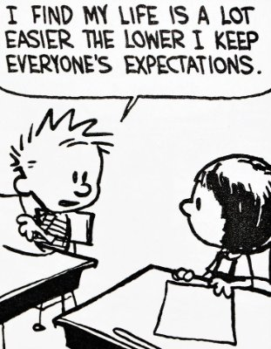
Expectations of this Talk
IS NOT…
This IS NOT a source to Copy/Paste Code into your project!!!
This IS NOT the only way to do DI or IOC!!!!
This IS NOT the best way to do DI or IOC!!!!
This IS NOT the only way to Mock or Test!!!!
This IS NOT the best way to Mock or Test!!!!
IS….
A conversation to get you TO THINK about DI and IOC
A conversation to get you TO THINK about Mocking and Testing
A conversation to get you TO SHARE your ideas with me and others

Slide 6
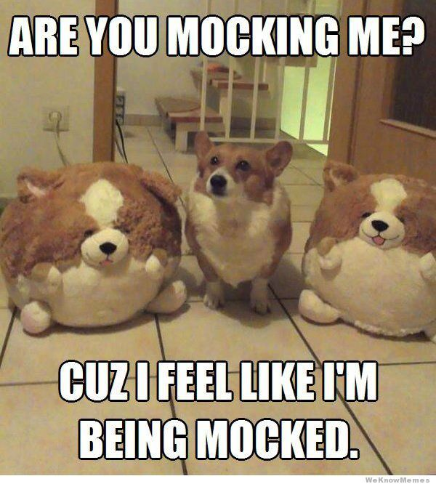
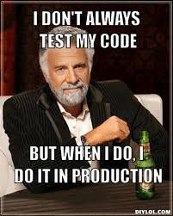
Main Event

Slide 7
What is DI? (Dependency Injection)

Slide 8
DI in C#

Slide 9
What is IOC? (Inversion of Control)

Slide 10
IOC in C# (.NET Framework - Ninject)

Slide 11
IOC in C# (.NET CORE 2.0 - Unity)

Slide 12
What is Mocking?

